Slide 1
Kleene’s Theorem and NFA
(Part III)

Slide 2
Rule 1
There is an FA that accepts any particular letter of the alphabet.
There is an FA that accepts only the word Λ.
September 11, 2018
Dr Aftab Maroof

Slide 3
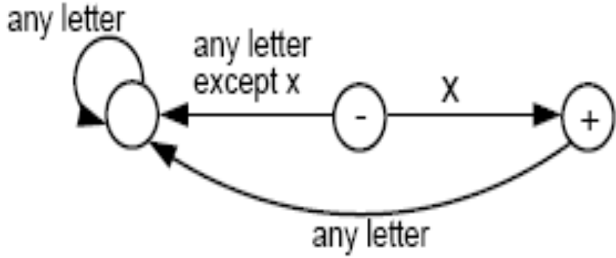
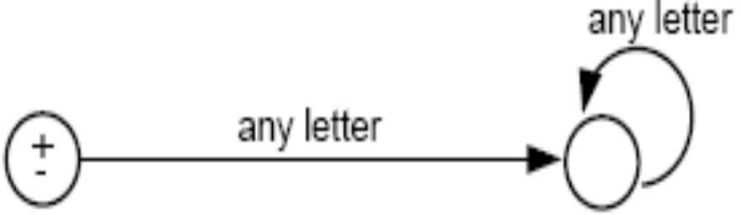
Proof of rule 1
If letter x is in ∑, then the following FA accepts only the word x.
The following FA accepts only λ:
September 11, 2018
Dr Aftab Maroof

Slide 4
Rule 2
If there is an FA called FA₁ that accepts the language defined by the regular expression r₁, and there is an FA called FA₂ that accepts the language defined by the regular expression r₂, then there is an FA that we shall call FA₃ that accepts the language defined by the regular expression (r₁ + r₂).
September 11, 2018
Dr Aftab Maroof

Slide 5
Proof of Rule 2
We shall show that FA₃ exists by presenting an algorithm showing how to construct FA₃.
Algorithm:
  – Starting with two machines, FA₁ with states x₁; x₂; x₃;…, and FA₂ with states y₁; y₂; y₃; …, we construct a new machine FA₃ with states z₁; z₂; z₃; … where each z_{i} is of the form x_{something} or y_{something}.
  – The combination state x_{start} or y_{start} is the start state of the new machine FA₃.
  – If either the x part or the y part is a final state, then the corresponding z is a final state.
September 11, 2018
Dr Aftab Maroof

Slide 6
Algorithm (cont.)
– To go from one state z to another by reading a letter from the input string, we observe what happens to the x part and what happens to the y part and go to the new state z accordingly. We could write this as a formula:
z_{new} after reading letter p =
(x_{new} after reading letter p on FA₁) or
(y_{new} after reading letter p on FA₂)
September 11, 2018
Dr Aftab Maroof

Slide 7
Remarks
The new machine FA₃ constructed by the above algorithm will simultaneously keep track of where the input would be if it were running on FA₁ alone, and where the input would be if it were running on FA₂ alone.
If a string traces through the new machine FA₃ and ends up at a final state, it means that it would also end at a final state either on machine FA₁ or on machine FA₂. Also, any string accepted by either FA₁ or FA₂ will be accepted by this FA₃. So, the language FA₃ accepts is the union of the languages accepted by FA₁ and FA₂, respectively.
Note that since there are only finitely many states x’s and finitely many states y’s, there can be only finitely many possible states z’s.
Let us look at an example illustrating how the algorithm works.
September 11, 2018
Dr Aftab Maroof

Slide 8
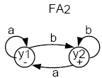
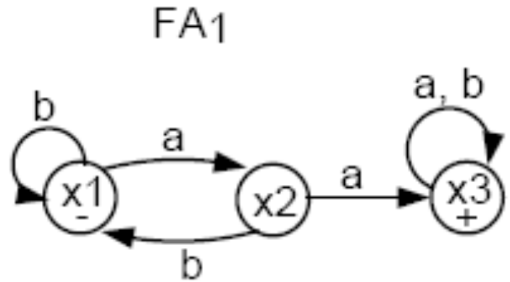
Example
Consider the following two FAs:
FA₁ accepts all words with a double a in them.
FA₂ accepts all words ending with b.
Let’s follow the algorithm to build FA₃ that accepts the union of the two languages.
September 11, 2018
Dr Aftab Maroof

Slide 9
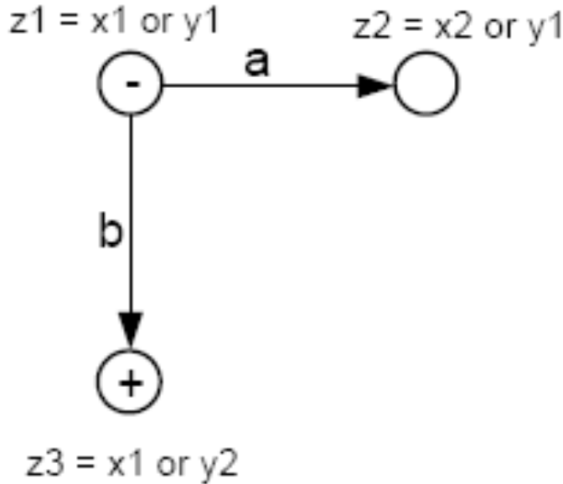
Combining the FAs
The start (-) state of FA₃ is z₁ = x₁ or y₁.
In z₁, if we read an a, we go to x₂ (observing FA₁), or we go to y₁ (observing FA₂).
Let z₂ = x₂ or y₁.
In z₁, if we read a b, we go to x₁ (observing FA₁), or to y₂ (observing FA₂).
Let z₃ = x₁ or y₂. Note that z₃ must be a final state since y₂ is a final state.
September 11, 2018
Dr Aftab Maroof

Slide 10
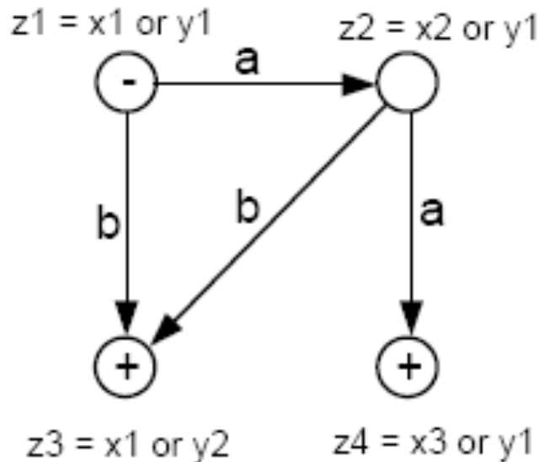
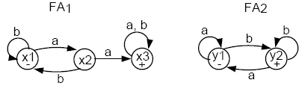
In z₂, if we read an a, we go to x₃ or y₁. Let z₄ = x₃ or y₁. z₄ is a final state because x₃ is.
In z₂, if we read a b, we go to x₁ or y₂, which is z₃.
September 11, 2018
Dr Aftab Maroof

Slide 11
In z₃, if we read an a, we go to x₂ or y₁, which is z₂.
In z₃, if we read a b, we go to x₁ or y₂, which is z₃.
In z₄, if we read an a, we go to x₃ or y₁, which is z₄. Hence, we have an a-loop at z₄.
In z₄, if we read a b, we go to x₃ or y₂. Let z₅ = x₃ or y₂. Note that z₅ is a final state because x₃ (and y₂) are.
In z₅, if we read an a, we go to x₃ or y₁, which is z₄.
In z₅, if we read a b, we go to x₃ or y₂, which is z₅. Hence, there is a b-loop at z₅.
The whole machine looks like the following:
September 11, 2018
Dr Aftab Maroof

Slide 12
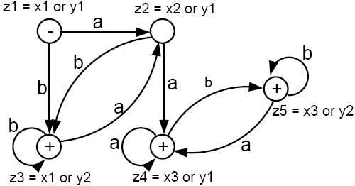
This machine accepts all words that have a double a or that end with b.
The labels z₁ = x₁ or y₁, z₂ = x₂ or y₁, etc. can be removed if you want.
September 11, 2018
Dr Aftab Maroof

Slide 13
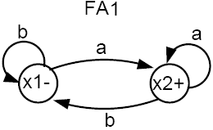
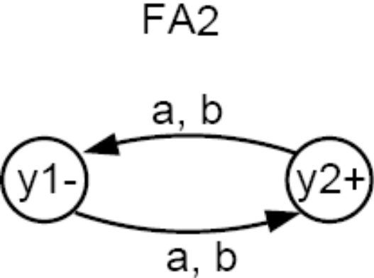
Example
Consider the following two FAs:
FA₁ accepts all words that end in a.
FA₂ accepts all words with an odd number of letters (odd length).
Can you use the algorithm to build a machine FA3 that accepts all words that either have an odd number of letters or end in a?
September 11, 2018
Dr Aftab Maroof

Slide 14
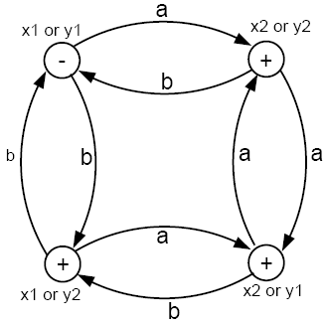
Using the algorithm, we can produce FA₃ that accepts all words that either have an odd number of letters or end in a, as follows:
The only state that is not a + state is the - state. To get back to that start state, a word must have an even number of letters and end in b.
September 11, 2018
Dr Aftab Maroof

Slide 15
Rule 3
If there is an FA₁ that accepts the language defined by the regular expression r₁, and there is an FA₂ that accepts the language defined by the regular expression r₂, then there is an FA₃ that accepts the language defined by the (concatenation) regular expression (r₁r₂), i.e. the product language.
September 11, 2018
Dr Aftab Maroof

Slide 16
We shall show that such an FA₃ exists by presenting an algorithm showing how to construct it from FA₁ and FA₂.
The idea is to construct a machine that starts out like FA₁ and follows along it until it enters a final state at which time an option is reached. Either we continue along FA₁, waiting to reach another +, or else we switch over to the start state of FA₂ and begin circulating there.
September 11, 2018
Dr Aftab Maroof

Slide 17
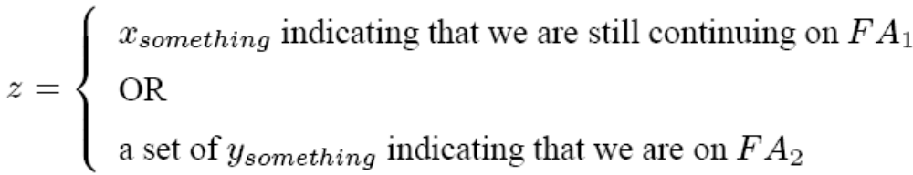
Algorithm
First, create a state z for every state of FA₁ that we may go through before arriving at a final state.
2. For each final state x_{final} of FA₁, add a state z = x_{final} or y₁, where y₁ is the start state of FA₂.
3. From the states added in step 2, add states
4. Label every state z that contains a final state from FA₂ as a final state.
September 11, 2018
Dr Aftab Maroof

Slide 18
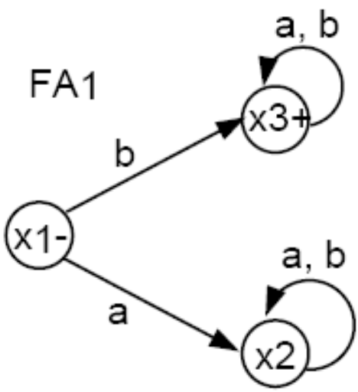
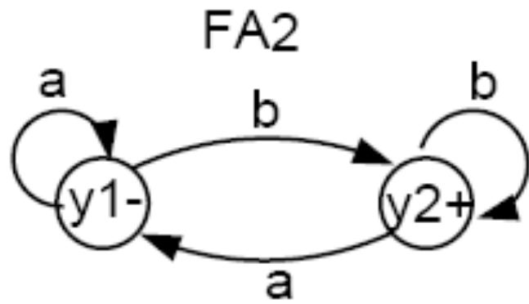
Example
FA₁ accepts all words that start with a b.
FA₂ accepts all words that end with a b.
We will use the above algorithm to construct FA₃ that accepts the product of the languages of FA₁ and FA₂, respectively. That is, FA₃ will accept all words that both start and end with the letter b.
September 11, 2018
Dr Aftab Maroof

Slide 19
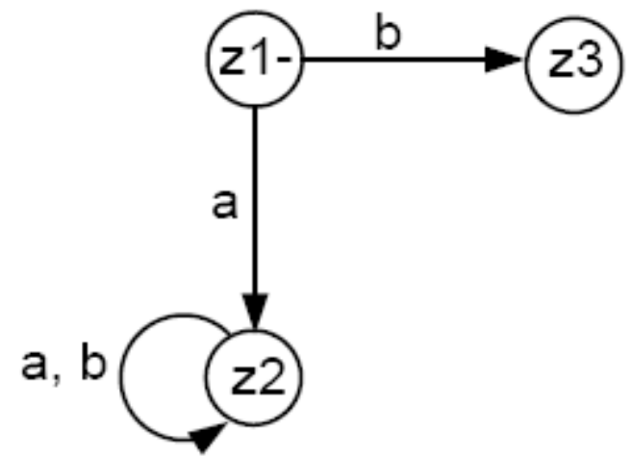
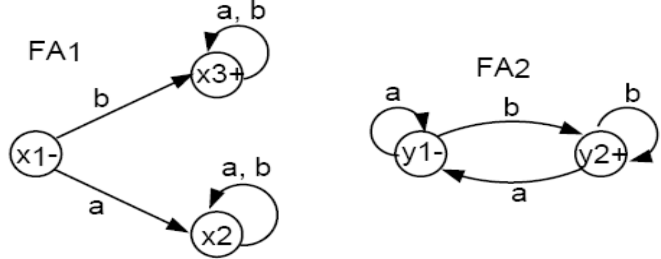
Initially, we must begin with x₁ = z₁.
In z₁, if we read an a, we go to x₂ = z₂.
In z₁, if we read a b, we go to x₃, a final state, which gives us the option to jump to y₁. Hence, we label z₃ = x₃ or y₁.
From z₂ just like x₂, both an a or a b take us back to z₂, i.e., we have a loop here.
Z₁ =X₁
Z₃ =X₃ or Y₁
Z₂ =X₂
September 11, 2018
Dr Aftab Maroof

Slide 20
In z3, if we read an a then the following happens. If z3 is x3, we can stay in x3 or jump to y1 (because x3 is a final state). If z3 is y1, we would loop back to y1. In any of the events, we end up at either x3 or y1, which is still z3. Hence, we have an a-loop at z3.
In z3, if we read a b, then a different event takes place. If z3 is x3 we either stay in x3 or jump to y1. If z3 is y1, then we go to y2, a final state. Hence, we need a new final state z4 = x3 or y1 or y2.
In z4, if we read an a, what happens? If z4 is x3 then we go back to x3 or jump to y1. If z4 is y1 then we loop back to y1. If z4 is y2, we go to y1. Thus, from z4, an a takes us to x3 or y1, which is z3.
In z4, if we read a b, what happens? If z4 is x3, we go back to x3 or jump to y1. If z4 is y1, we go to y2, a final state. If z4 is y2, we loop back to y2, a final state. Hence, from z4 a b takes us to x3 or y1 or y2, which is still z4 (i.e., we have a b-loop here).
September 11, 2018
Dr Aftab Maroof

Slide 21
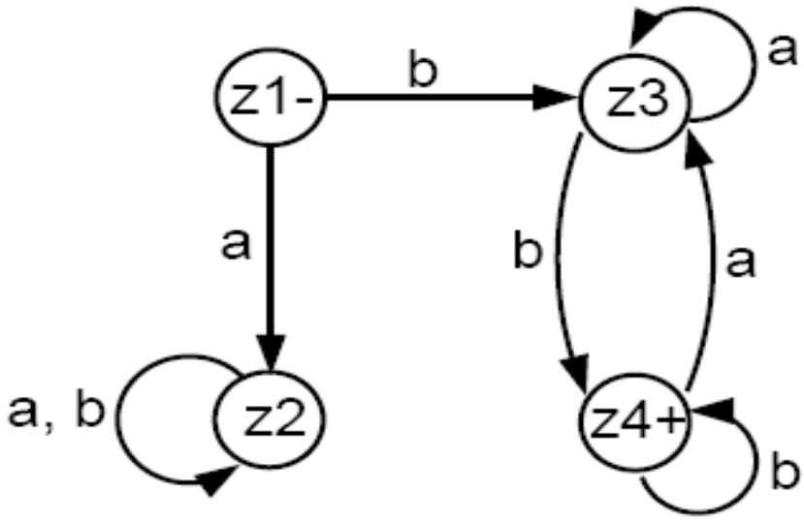
x
Z₃ =X₃ or Y₁
Z₁ =X₁
This machine accepts all words that both begin and end with the letter b, which is what the product of the two languages (defined by FA₁ and FA₂ respectively) would be.
`
If you multiply the two languages in opposite order (i.e. first FA₂ then FA₁), then the product language will be different. What is that language? Can you build a machine for that product language
Z₂ =X₂
Z₄ =X₃ or Y₂
September 11, 2018
Dr Aftab Maroof

